Slide 1
Bank Loan Rate
By – Neeraj Bapat

Slide 2
Table of Content
Introduction
Advantages of the project
Process flow
Content of Data
Conclusion

Slide 3
Introduction
Objective - To determine the rate at which a bank gives loan to applicants.
I chose this project for learning about Banking and Finance sector.
This data was sourced from Kaggle and having 981 rows and 16 columns.

Slide 4
Advantages
Help in determining whether the applicant is eligible for receiving the loan.
To identify and reduce risk of loan defaulters.
Helpful for bank in understanding their customers.

Slide 5
Process Flow
Data Understanding
Data Visualization using Tableau
Conclusion

Slide 6
Bank Loan
A bank loan is lump sum, amount of money lent to a receiver , which they have to repay over a fixed period of time with a interest.
Requirements for a personal loan
Age – Between 18 to 60
Debt to income ratio – The ability for a person tom repay the loan based on their income
Cibil Score – A score given by an organization reflecting their creditworthiness.
Employment stability – The person must have a stable job with income

Slide 7
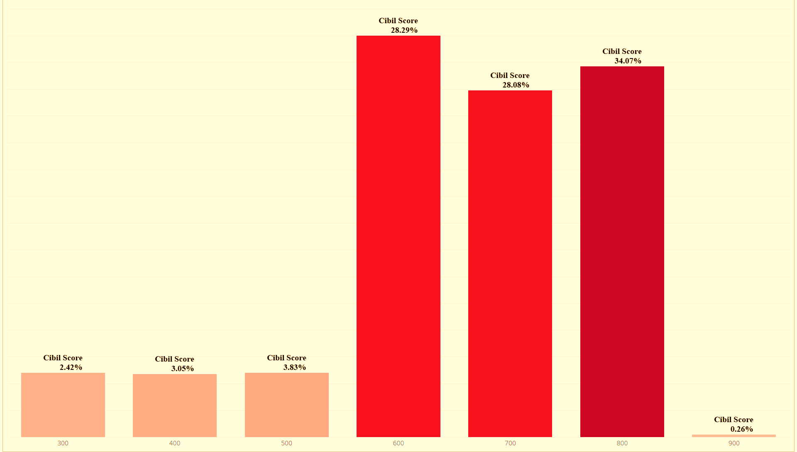
Cibil Score
Applicants having Cibil Score of 600 and higher are preferred for loan sanctioning.

Slide 8
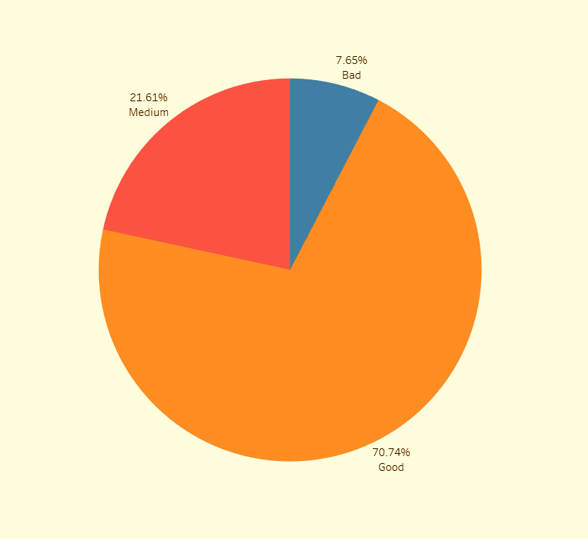
Customer Bandwidth
The categorization of applicant based on their previous record.
People paying their dues on time are categorized as good customers
People not paying their dues on time are categorized as bad customers.
People paying their dues inconsistently are categorized as medium customers.

Slide 9
Conclusion
People who are eligible for a bank loan -
Cibil Score > 600
Taken Previous Loan
Debt to Income Ratio > 10 %
Tenure high
Loan Rejection chances – 7%

Slide 10
Conclusion
People rejected for reducing of defaulters -
Cibil Score < 600
Previous Loan Taken
Debt to Income Ratio < 10 %
Tenure very small
Loan Rejection chances – 100 %

Slide 11
THANK YOU

